Slide 1
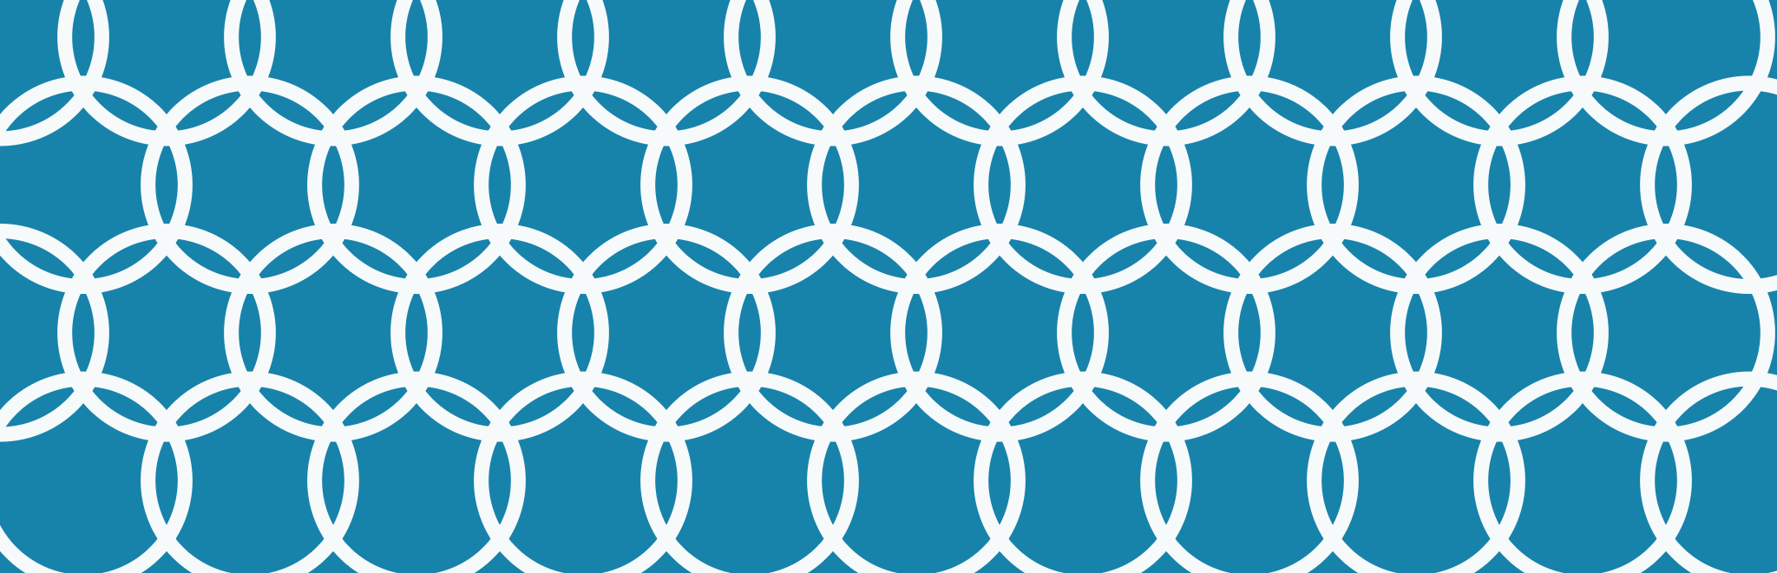
Computer Graphics (4)
Lab 4 · Color Systems: RGB, CMY and HSV
Notes:
Week 4 lab. Builds on Lab 3 (global variables, init2D, display, primitives, circles, text). Today: how OpenGL handles color, additive vs subtractive mixing, and converting between RGB and HSV.

Slide 2
Agenda
01
Color in OpenGL
02
The RGB cube
03
Color swatches
04
Smooth shading
05
Additive mixing (RGB)
06
Subtractive mixing (CMY)
07
The HSV model
08
RGB to HSV
09
HSV to RGB
10
Color wheel
11
Complements and pitfalls
12
Lab tasks
2

Slide 3
Color in OpenGL
Each component is a float from 0.0 to 1.0 (or a byte from 0 to 255 with the ub version).
// background color
glClearColor(0.0, 0.0, 1.0, 1.0);
// current drawing color
Values outside the range are clamped: glColor3f(255, 0, 0) is just red, not "255 times red".
glColor3f(1.0, 0.0, 0.0);
// the same red, as bytes
glColor3ub(255, 0, 0);
The color is a state: every vertex after glColor uses it until you change it.
3
Notes:
Recap from Lab 3: glClearColor is called once in init2D; glColor3f was used before drawing shapes. Stress that it is a state machine.

Slide 4
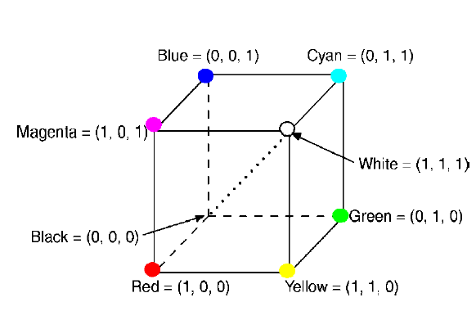
The RGB cube
Corner | R | G | B
Black | 0 | 0 | 0
Red | 1 | 0 | 0
Green | 0 | 1 | 0
Blue | 0 | 0 | 1
Yellow | 1 | 1 | 0
Cyan | 0 | 1 | 1
Magenta | 1 | 0 | 1
White | 1 | 1 | 1
Grays live on the diagonal
When R = G = B the color has no hue: it is a gray level between black (0, 0, 0) and white (1, 1, 1).
Mixing light is additive: adding all three primaries gives white, and no light at all gives black.
4
Notes:
Lecture slide: The RGB color model. The eight corners of the unit cube are the colors we draw next.

Slide 5
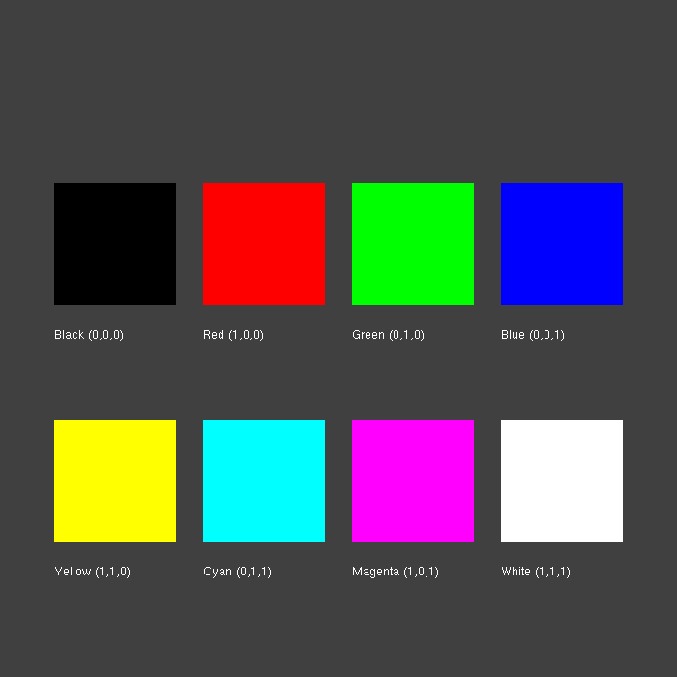
Color swatches
float colors[8][3] = {
{0,0,0}, {1,0,0}, {0,1,0}, {0,0,1},
{1,1,0}, {0,1,1}, {1,0,1}, {1,1,1}};
for (int i = 0; i < 8; i++) {
float x = 8 + (i % 4) * 22;
float y = 55 - (i / 4) * 35;
glColor3f(colors[i][0], colors[i][1], colors[i][2]);
glBegin(GL_QUADS);
glVertex2f(x, y);
glVertex2f(x, y + 18);
glVertex2f(x + 18, y + 18);
glVertex2f(x + 18, y);
glEnd();
}
5
Notes:
Background is dark gray so that black and white swatches are both visible. printSome from Lab 3 writes the label under each square. Full file: swatches.cpp.

Slide 6

Smooth shading
// in init2D(): colors blend between vertices
glShadeModel(GL_SMOOTH);
glBegin(GL_TRIANGLES);
glColor3f(1, 0, 0); glVertex2i(10, 40);
glColor3f(0, 1, 0); glVertex2i(45, 40);
glColor3f(0, 0, 1); glVertex2i(27, 90);
glEnd();
glBegin(GL_QUADS);
glColor3f(0, 0, 0); glVertex2i(10, 10);
glVertex2i(10, 25);
glColor3f(1, 1, 1); glVertex2i(90, 25);
glVertex2i(90, 10);
glEnd();
A color set before a vertex belongs to that vertex. OpenGL interpolates in between.
6
Notes:
GL_SMOOTH is the default; GL_FLAT would use a single color per primitive. The quad on the right of the screenshot uses four different corner colors; its code is in gradient.cpp.

Slide 7
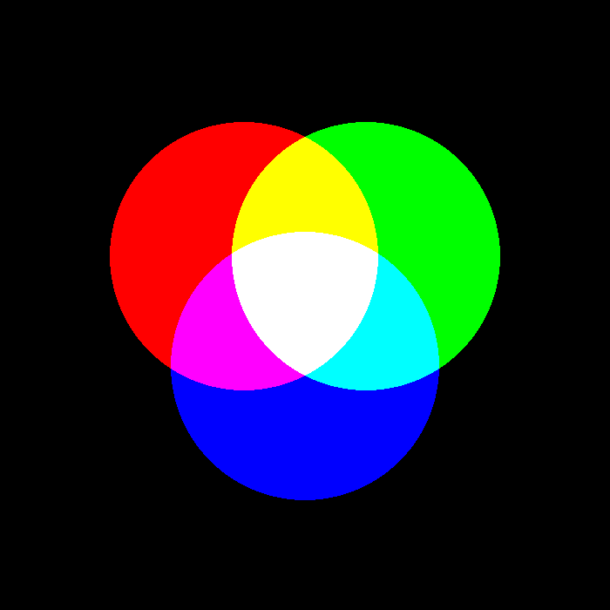
Additive mixing (RGB)
// init2D(): start from black
glClearColor(0, 0, 0, 1);
glEnable(GL_BLEND);
glBlendFunc(GL_ONE, GL_ONE);
// result = source + destination
glColor3f(1, 0, 0); DrawCircle(40, 58, 22, 100);
glColor3f(0, 1, 0); DrawCircle(60, 58, 22, 100);
glColor3f(0, 0, 1); DrawCircle(50, 40, 22, 100);
R + G = yellow · G + B = cyan · R + B = magenta · R + G + B = white
7
Notes:
DrawCircle is the solid version from Lab 3 (GL_POLYGON). Blending adds the new color to what is already in the frame buffer, exactly like projectors throwing light on the same spot (lecture slide: additive mixture).

Slide 8
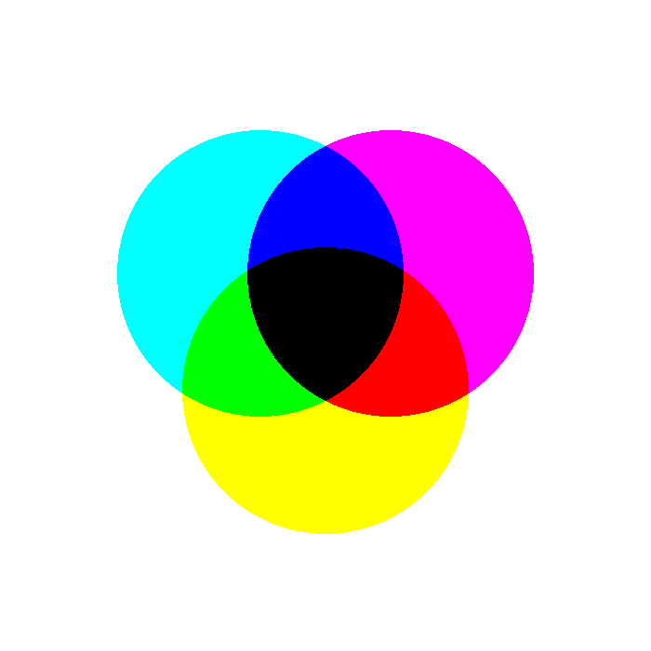
Subtractive mixing (CMY)
// OpenGL only knows RGB: R = 1 - C
void setColorCMY(float c, float m, float y) {
glColor3f(1.0 - c, 1.0 - m, 1.0 - y);
}
// init2D(): ink on WHITE paper
glClearColor(1, 1, 1, 1);
glEnable(GL_BLEND);
glBlendFunc(GL_DST_COLOR, GL_ZERO);
// result = source * destination
setColorCMY(1, 0, 0); DrawCircle(40, 58, 22, 100);
C + M = blue · M + Y = red · C + Y = green · C + M + Y = black
8
Notes:
Multiplying by the destination models a filter: each ink removes (subtracts) part of the white light. Cyan (0,1,1) times magenta (1,0,1) gives (0,0,1) = blue. The other two circles are drawn the same way with magenta and yellow.

Slide 9
CMY = 1 − RGB
Color | RGB | CMY
Red | (1, 0, 0) | (0, 1, 1)
Green | (0, 1, 0) | (1, 0, 1)
Blue | (0, 0, 1) | (1, 1, 0)
White | (1, 1, 1) | (0, 0, 0)
Black | (0, 0, 0) | (1, 1, 1)
Gray | (0.5, 0.5, 0.5) | (0.5, 0.5, 0.5)
Light versus ink
RGB adds light to black: screens, key color white.
CMY(K) removes light from white: printers, key color black.
The RGB gamut is larger than CMYK, so some screen colors lose vibrancy when printed.
9
Notes:
Lecture slide: CMY(K) color model and color gamut. In code, the conversion is just 1 minus each component, which is what setColorCMY does.

Slide 10
The HSV model
Hue
Saturation
Value
0° – 360°
0 – 100%
0 – 100%
The kind of color: red 0°, green 120°, blue 240°.
Colorfulness: 0 is gray, 100 is the purest color.
Brightness: 0 is black, 100 is the brightest.
Red = (0°, 100%, 100%) · Green = (120°, 100%, 100%) · Blue = (240°, 100%, 100%) · Gray = (0°, 0%, 50%)
10
Notes:
Lecture slides: HSV (hue-saturation-value). HSV describes color the way people do, which makes it easier to ask for "the same color, but paler". OpenGL still needs RGB, so we convert.

Slide 11
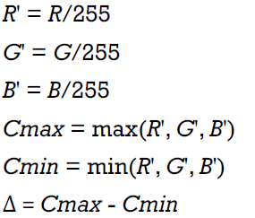
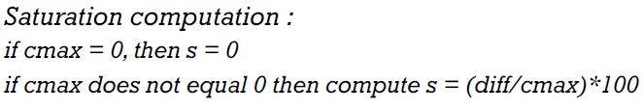
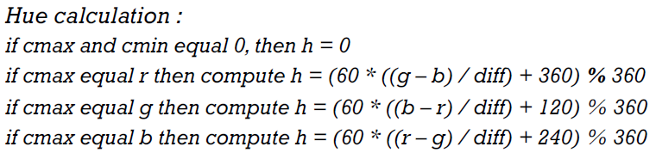

RGB to HSV
void rgbToHSV(float r, float g, float b,
float &h, float &s, float &v)
{
r /= 255.0; g /= 255.0; b /= 255.0;
float cmax = fmaxf(r, fmaxf(g, b));
float cmin = fminf(r, fminf(g, b));
float diff = cmax - cmin;
if (diff == 0) h = 0;
else if (cmax == r) h = fmodf(60 * ((g - b) / diff) + 360, 360);
else if (cmax == g) h = fmodf(60 * ((b - r) / diff) + 120, 360);
else h = fmodf(60 * ((r - g) / diff) + 240, 360);
s = (cmax == 0) ? 0 : (diff / cmax) * 100;
v = cmax * 100;
}
Five steps
1 Divide r, g, b by 255
2 Find cmax, cmin and diff
Step 1 , 2:
3 Hue depends on which channel is the maximum
4 Saturation = diff / cmax
5 Value = cmax
h in degrees, s and v in percent, as in the lecture.
Step 4:
Step 3:
11
Step 5:
Notes:
Direct translation of the lecture slide. The (+360) before the modulo keeps the red-dominant branch positive. Make sure you divide the diff by cmax only when cmax is not zero (a black pixel).

Slide 12
Example: (45, 215, 0) to HSV
Step | Result
1 Divide by 255 | R' = 0.17647 · G' = 0.84313 · B' = 0
2 Max, min, diff | cmax = G' = 0.84313 · cmin = 0 · diff = 0.84313
3 Hue (cmax is G') | 60 × ((0 − 0.17647) / 0.84313) + 120 = 107.44°
4 Saturation | 0.84313 / 0.84313 × 100 = 100
5 Value | 0.84313 × 100 = 84.31
rgbToHSV(45, 215, 0, h, s, v);
// h = 107.44, s = 100.00, v = 84.31
12
Notes:
Same example as the lecture. Ask students to print the result of their function and compare with these numbers before moving on.

Slide 13
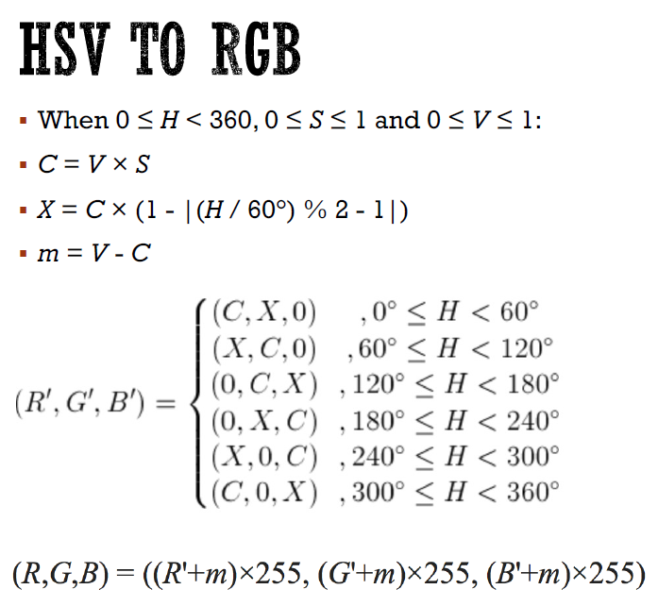
HSV to RGB
void hsvToRGB(float h, float s, float v,
float &r, float &g, float &b)
{
h = fmodf(h, 360);
if (h < 0) h += 360;
s /= 100.0; v /= 100.0;
float C = v * s;
float X = C * (1 - fabsf(fmodf(h / 60.0, 2) - 1));
float m = v - C;
float r1, g1, b1;
if (h < 60) { r1 = C; g1 = X; b1 = 0; }
else if (h < 120) { r1 = X; g1 = C; b1 = 0; }
else if (h < 180) { r1 = 0; g1 = C; b1 = X; }
else if (h < 240) { r1 = 0; g1 = X; b1 = C; }
else if (h < 300) { r1 = X; g1 = 0; b1 = C; }
else { r1 = C; g1 = 0; b1 = X; }
r = (r1 + m) * 255; g = (g1 + m) * 255; b = (b1 + m) * 255;
}
What the letters mean
C the chroma: how far the color is from gray
X the second largest component
m the amount added to every channel to match the value
Each 60° sector of the hue circle puts C, X and 0 into a different channel.
13
Notes:
Direct translation of the lecture formulas. Output r, g, b are in 0..255, so divide by 255 before calling glColor3f, or use glColor3ub / setColorHSV.

Slide 14
Example: (280°, 50%, 90%) to RGB
Step | Result
1 Normalize | S = 0.5 · V = 0.9
2 Chroma | C = V × S = 0.45
3 Second component | X = 0.45 × (1 − |(280 / 60) % 2 − 1|) = 0.30
4 Offset | m = V − C = 0.45
5 Sector 240° to 300° | (R', G', B') = (X, 0, C) = (0.30, 0, 0.45)
6 Add m, scale by 255 | (R, G, B) = (191, 115, 230)
hsvToRGB(280, 50, 90, r, g, b);
// r = 191, g = 115, b = 230
14
Notes:
Same example as the lecture. A good checkpoint: if students get (191, 115, 230) from their function, the conversion is correct.

Slide 15
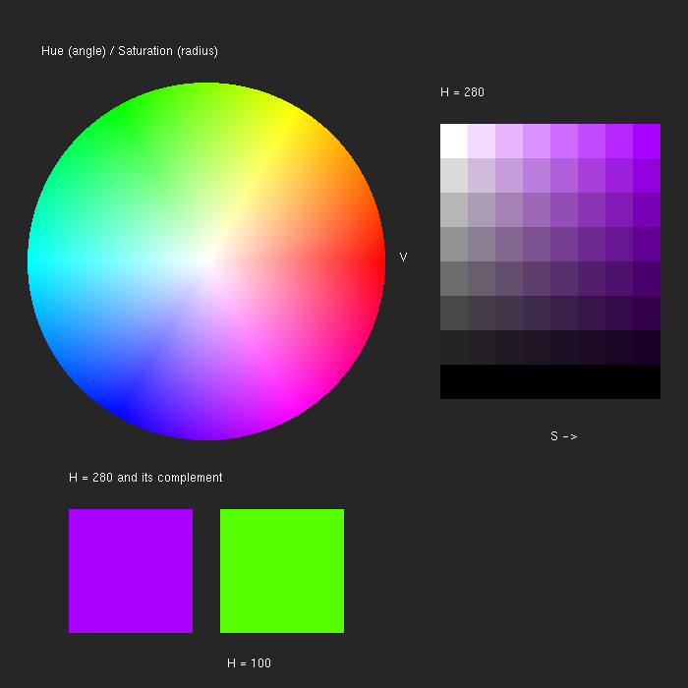
Color wheel
void DrawColorWheel(float cx, float cy, float r) {
glBegin(GL_TRIANGLES);
for (int i = 0; i < 360; i++) {
float a0 = 2 * 3.1415926f * i / 360;
float a1 = 2 * 3.1415926f * (i + 1) / 360;
setColorHSV(i, 0, 100); // center
glVertex2f(cx, cy);
setColorHSV(i, 100, 100); // edge 1
glVertex2f(cx + r * cosf(a0), cy + r * sinf(a0));
setColorHSV(i + 1, 100, 100); // edge 2
glVertex2f(cx + r * cosf(a1), cy + r * sinf(a1));
}
glEnd();
}
360 thin triangles: hue is the angle, saturation grows from the center to the edge.
15
Notes:
Uses setColorHSV from hsv_utils.h (it calls hsvToRGB, then glColor3f(r/255, g/255, b/255)). The screenshot also shows a saturation/value grid for hue 280 (DrawSVGrid) and a complementary pair at the bottom, all from wheel.cpp.

Slide 16
Complementary colors
Hue | Complement (H + 180°)
Red 0° | Cyan 180°
Yellow 60° | Blue 240°
Green 120° | Magenta 300°
Purple 280° | Green 100°
setColorHSV(h, 100, 100);
DrawSwatch(10, 10, 20, 20);
setColorHSV(h + 180, 100, 100);
DrawSwatch(35, 10, 20, 20);
Side by side they give the strongest contrast. Mixed together they cancel to gray.
16
Notes:
hsvToRGB already wraps the hue with fmodf, so h + 180 can exceed 360. Lecture slide: complementary hues. These are the complements on the RGB color wheel, which is not the same wheel as the artist's red-yellow-blue wheel.

Slide 17
Common pitfalls
Integer division
Wrong scale
Blending left on
i / 7 is 0 for every i below 7. Write i / 7.0 to get a gray ramp.
glColor3f wants 0 to 1. Our HSV code returns 0 to 255, so divide by 255.
Text and opaque shapes look wrong. Call glDisable(GL_BLEND) when you are done.
Background order
Hue out of range
Divide by zero
Draw backgrounds first, with blending off, then the blended circles.
h + 180 can pass 360. Wrap it with fmodf and fix negative values.
Gray and black pixels have diff = 0 or cmax = 0. Check before dividing.
17
Notes:
Each of these is a bug that is easy to hit during the tasks. Ask students to keep this slide open while they work.

Slide 18
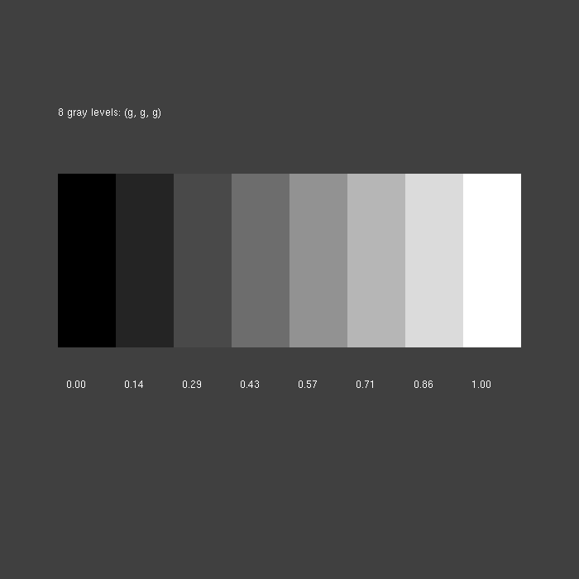
Task 1: Gray ramp
Draw 8 squares from black to white with a for loop.
Use gray = i / 7.0 and glColor3f(gray, gray, gray).
Print each gray value under its square with printSome.
Hint
R = G = B means you are walking along the main diagonal of the RGB cube. Use sprintf to turn the number into text.
18
Notes:
Warm-up. Expected output is the screenshot. Solution: task1_gray.cpp.

Slide 19
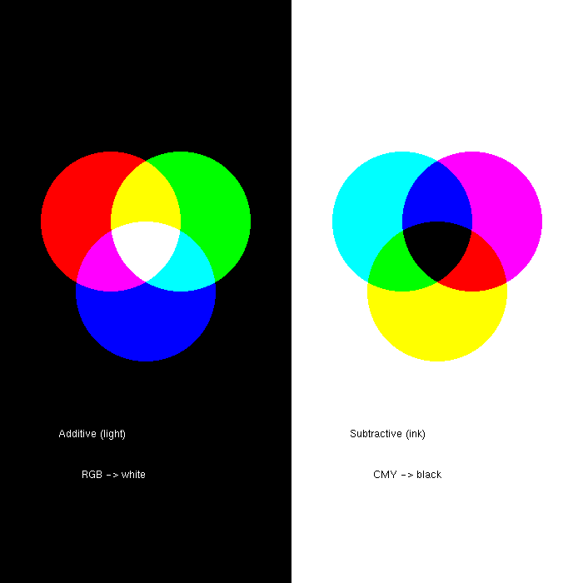
Task 2: Light versus ink
Left half: black background with red, green and blue circles added together.
Right half: white background with cyan, magenta and yellow circles multiplied.
Label each half.
Hint
Draw both backgrounds with blending disabled, then enable it and switch glBlendFunc between the two halves.
19
Notes:
Combines the additive and subtractive slides. Solution: task2_venn.cpp.

Slide 20
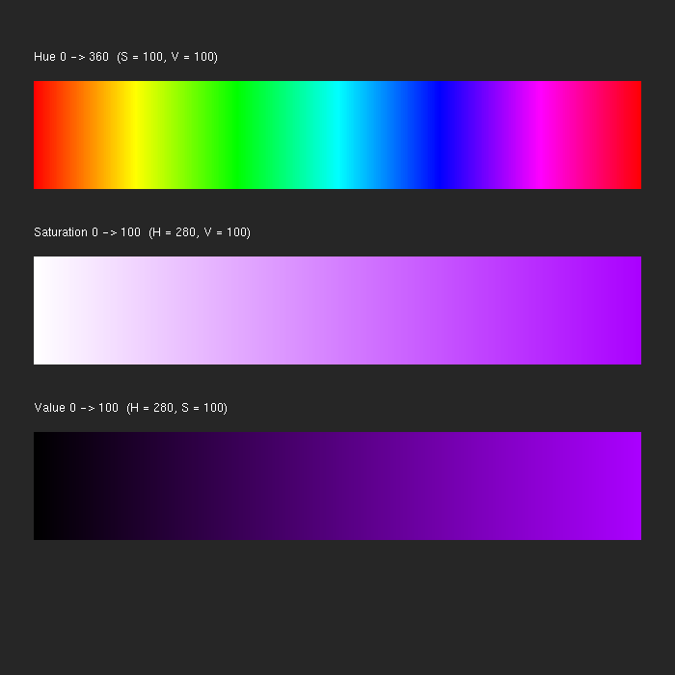
Task 3: HSV strips
Write rgbToHSV and hsvToRGB and check them with the two worked examples.
Draw three strips of 360 thin quads: hue 0 to 360, saturation 0 to 100 and value 0 to 100.
Use H = 280 for the last two strips and label each strip.
Hint
Make a helper setColorHSV(h, s, v) that calls hsvToRGB and then glColor3f(r / 255, g / 255, b / 255).
20
Notes:
This is the main task of the lab. Solution: task3_hsv.cpp together with hsv_utils.h. Each quad is 90 / 360 = 0.25 logical units wide.

Slide 21
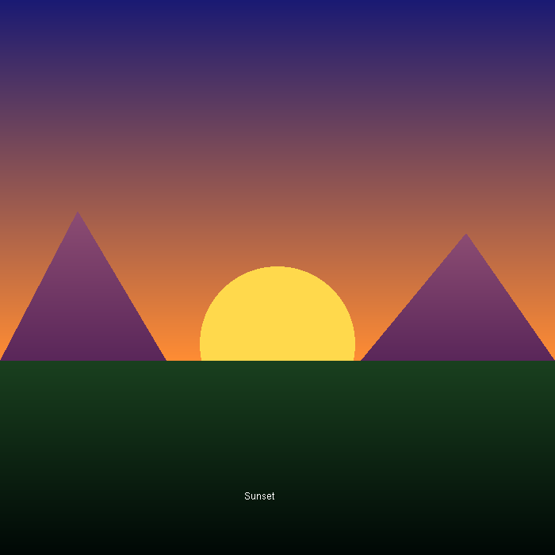
Task 4: Sunset scene
Sky: a quad that is dark blue at the top and orange at the horizon.
Sun: a warm yellow circle, half hidden by the ground.
Two mountains: triangles that are lighter at the peak.
Ground: a quad from dark green to almost black. Write "Sunset" with printSome.
Hint
Draw back to front: sky, sun, mountains, ground. Per-vertex colors give you the gradients.
21
Notes:
Scene task in the same spirit as the stop sign and welcome scenes from Lab 3. Colors are suggestions: students can pick their own, for example in HSV. Solution: task4_sunset.cpp.

Slide 22
Bonus: rotate the hue
Draw a circle in the current hue and a square in its complement.
Press D to add 10° to the hue and A to subtract 10°.
Print the current hue on screen.
float hue = 0;
void keyboard(unsigned char key, int x, int y)
{
if (key == 'd') hue += 10;
if (key == 'a') hue -= 10;
glutPostRedisplay();
}
// in main(), before glutMainLoop():
glutKeyboardFunc(keyboard);
Your display function is called again every time you call glutPostRedisplay.
22
Notes:
Optional for students who finish early. glutKeyboardFunc is new in this lab. Note that hue can become negative after pressing A, which hsvToRGB handles.

Slide 23
Thanks
Questions?
23

